Slide 1
Sales Project
Presenter : Ashok Meena
Challenge : Provide insight to understand their sales and customer base in online sales.
Domain : E- commerce
Company Name – A2Z Retails
Tools Used : Microsoft SQL, Power BI

Slide 2
ABOUT A2Z Retails
A2Z retails is Chicago based company started in 2018, aiming to expand it Business in USA
Background :
A2Z retails deals in Multi-brands product having multiple products in categories via social websites like you-tube , google ads since 2018.
Starting with year 2019 they started offering discount coupon to increase their sales .
Stakeholder’s now wanted to understand their customer base and review business performance over the year sales .
Objective :-
The objective is to create dashboard to convert sales results and get meaningful insight’s for stakeholder’s which can be used to drive action’s and deeper understanding of their customers.

Slide 3
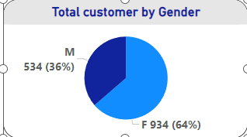
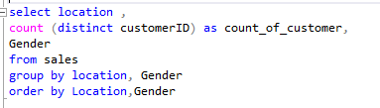
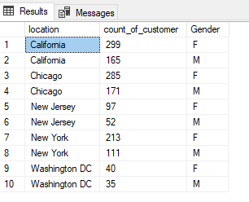
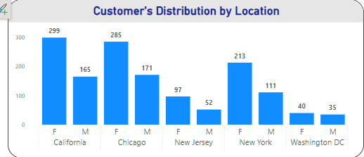
Demographics insights
•Explore the distribution of customers based on gender and location.
Query
Output

Slide 4
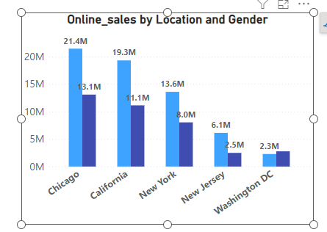
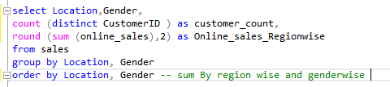
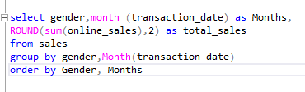
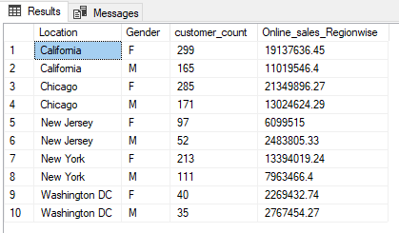
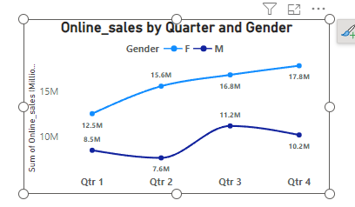
sales pattern of gender– over the time and location
•Explore the sales pattern based on gender and location and over the time.
Query
Output

Slide 5
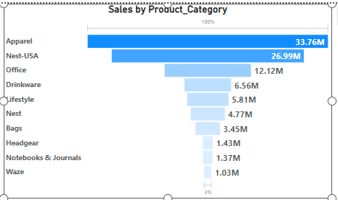

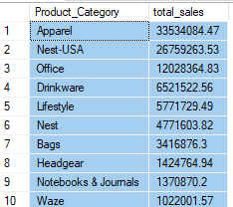
Product Insight
Examine the most popular product categories and products based on sales quantity or amount.
Query
Output

Slide 6
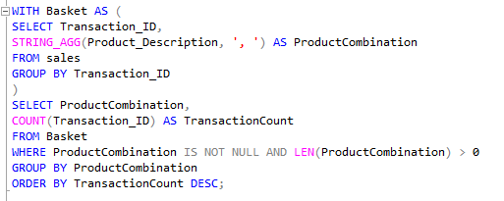
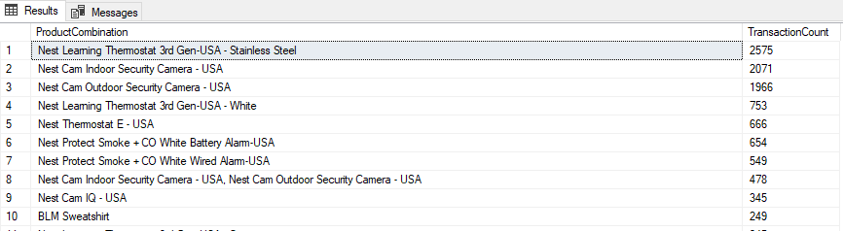
Basket analysis
Explore which products are frequently purchased together. This can inform bundling strategies or recommendations.-
Query
Output

Slide 7
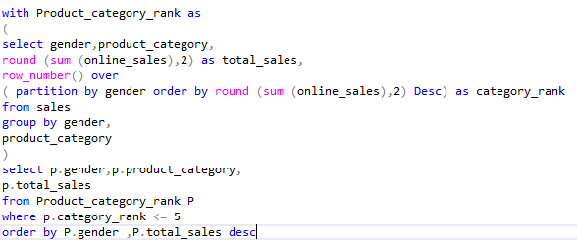
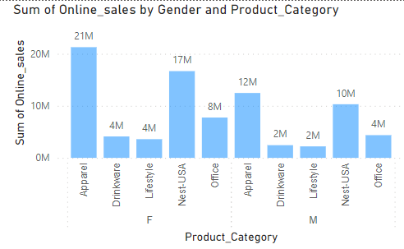
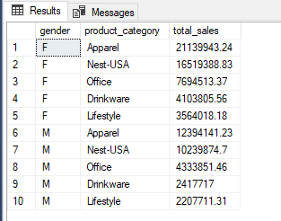
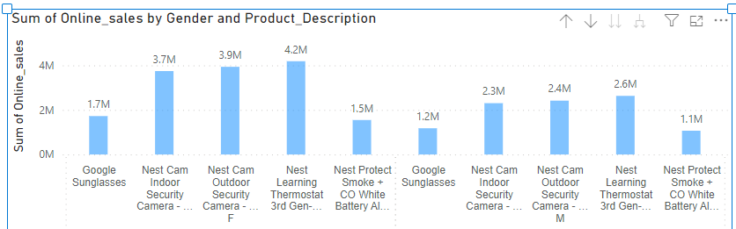
Examine the most popular product categories among genders and products based on sales quantity or amount
Query
output

Slide 8
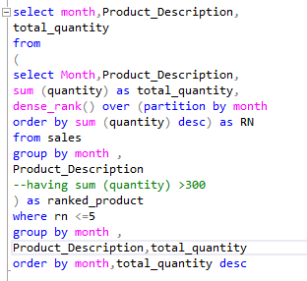
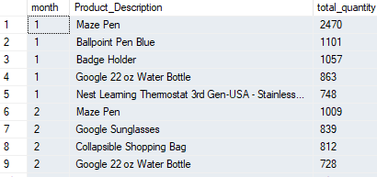
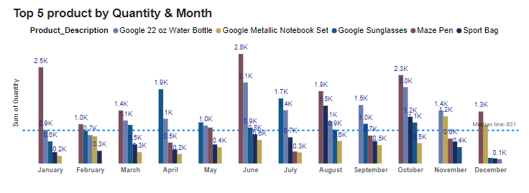
Monthly product sale
Examine the top 5 most demanded products every month based on sales quantity to maintain stock supply on continuous basis .
Query Output

Slide 9

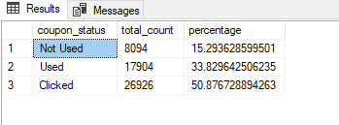
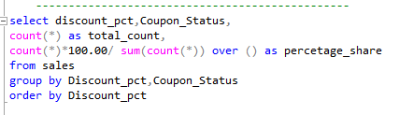
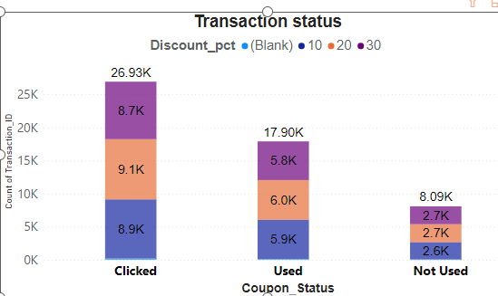
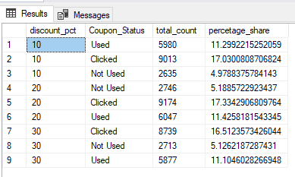
Coupon Code Analysis:
Evaluate the performance of different coupon codes in terms of usage and impact on sales.
Query
output

Slide 10
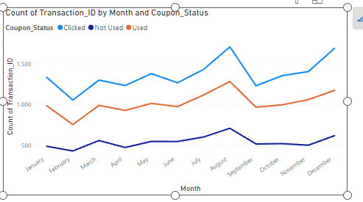
Coupon Code analysis

Slide 11
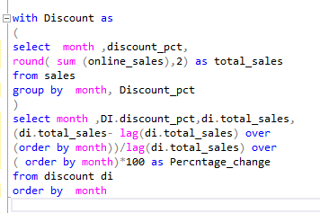
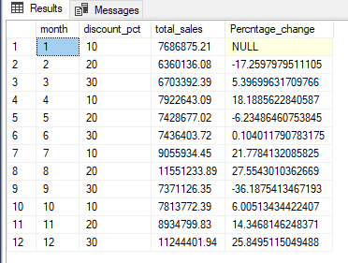
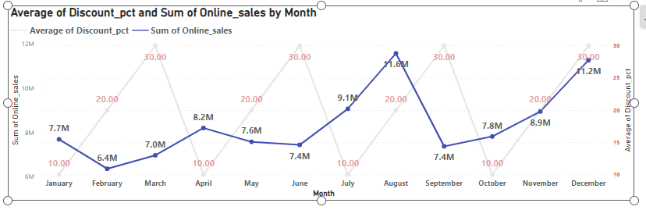
Impact of discount % over sales
Evaluate the performance of different coupon codes in terms of usage and impact on sales.
Query output

Slide 12
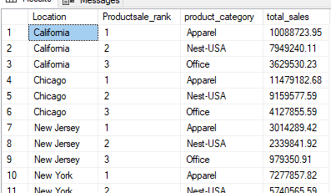
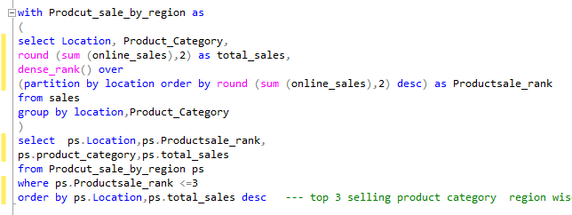
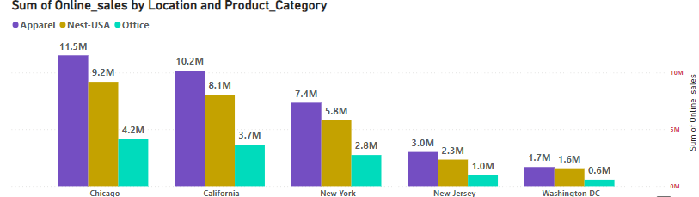
Locational analysis
Explore regional sales dynamics
Top 3 category product by sales and quantity
query

Slide 13
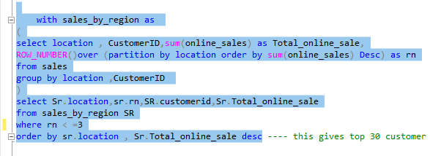
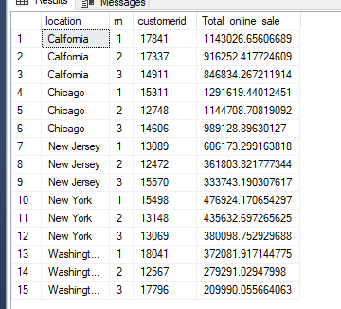
Top 10 valuable customer
Query

Slide 14
Recommendation
A2Z retails major customer base is female we observe a consistent upward trend in sales by female customers across locations and constitute 63% of yearly sales and 37.41% by Males customers respectively and significant downward trends in sales from July to oct months even after across genders even promotional (Discount % running 10 %,20%,30%) further significant spike in November -December due to Higher promotional Discounts (coupon code 30%).
This reflects price sensitivity among customer with discount %. This surge can be attributed to the successful implementation of promotional campaign. The average transaction amount also increased during this period, indicating that customers took advantage of the discounts to make larger purchases.
The top-selling products consistently include Google sunglasses, Nest com Indoor and outdoor security cameras, nest protect smoke + CO white alarm among product categories of apparels, Nest USA, and Office, lifestyle, Bags, Drinkware suggesting a sustained demand for these products. However, it's noteworthy that the sales of accessories, such as NESTOUTDOOR CAMERA, and BOTTLES, experienced a sharp increase in December, possibly due to holiday.
Further it has been identified OFFICE product category have consistent sales across month thus I recommend leveraging the success of the promotional campaign by planning targeted promotions during peak shopping seasons.

Slide 15
recommendations
Additionally, exploring opportunities to bundle accessories with popular products could capitalize on the observed trend in accessory sales during the holiday season.
Location-wise Performance: -
- California, Chicago consistently outperformed other locations, showing a higher growth rate in sales compared to the average 1.5 M
- All Location faced some challenges during the Aug/ September months, even when higher promotional marketing campaign thus showing dip in sales. Further investigation is recommended to understand contributing factors.
Seasonal analysis indicates that except New York all other location experiences a surge in sales during the holiday season, suggesting an opportunity for targeted promotions
Recommendation: A analysis suggests a positive relationship between promotional activities and increased sales. Implementing targeted promotions could enhance overall sales

